Slide 1

The Red Cross
Notes:
What’s one of the major obstacles for large organisations?
They’re slow to adapt to change.
We have chosen to work on a project for The Red Cross,
because the influx of migrants has given them a lot of work to do.
They are looking for a tool which can raise the motivation of their members, and also allow them to become more responsive to social change.

Slide 2
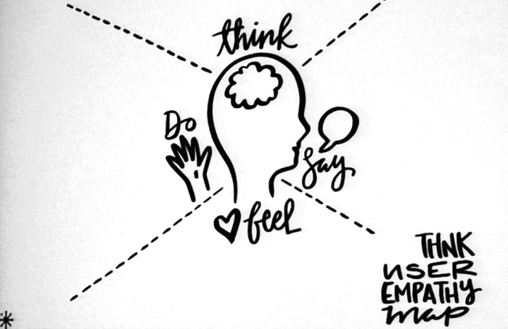
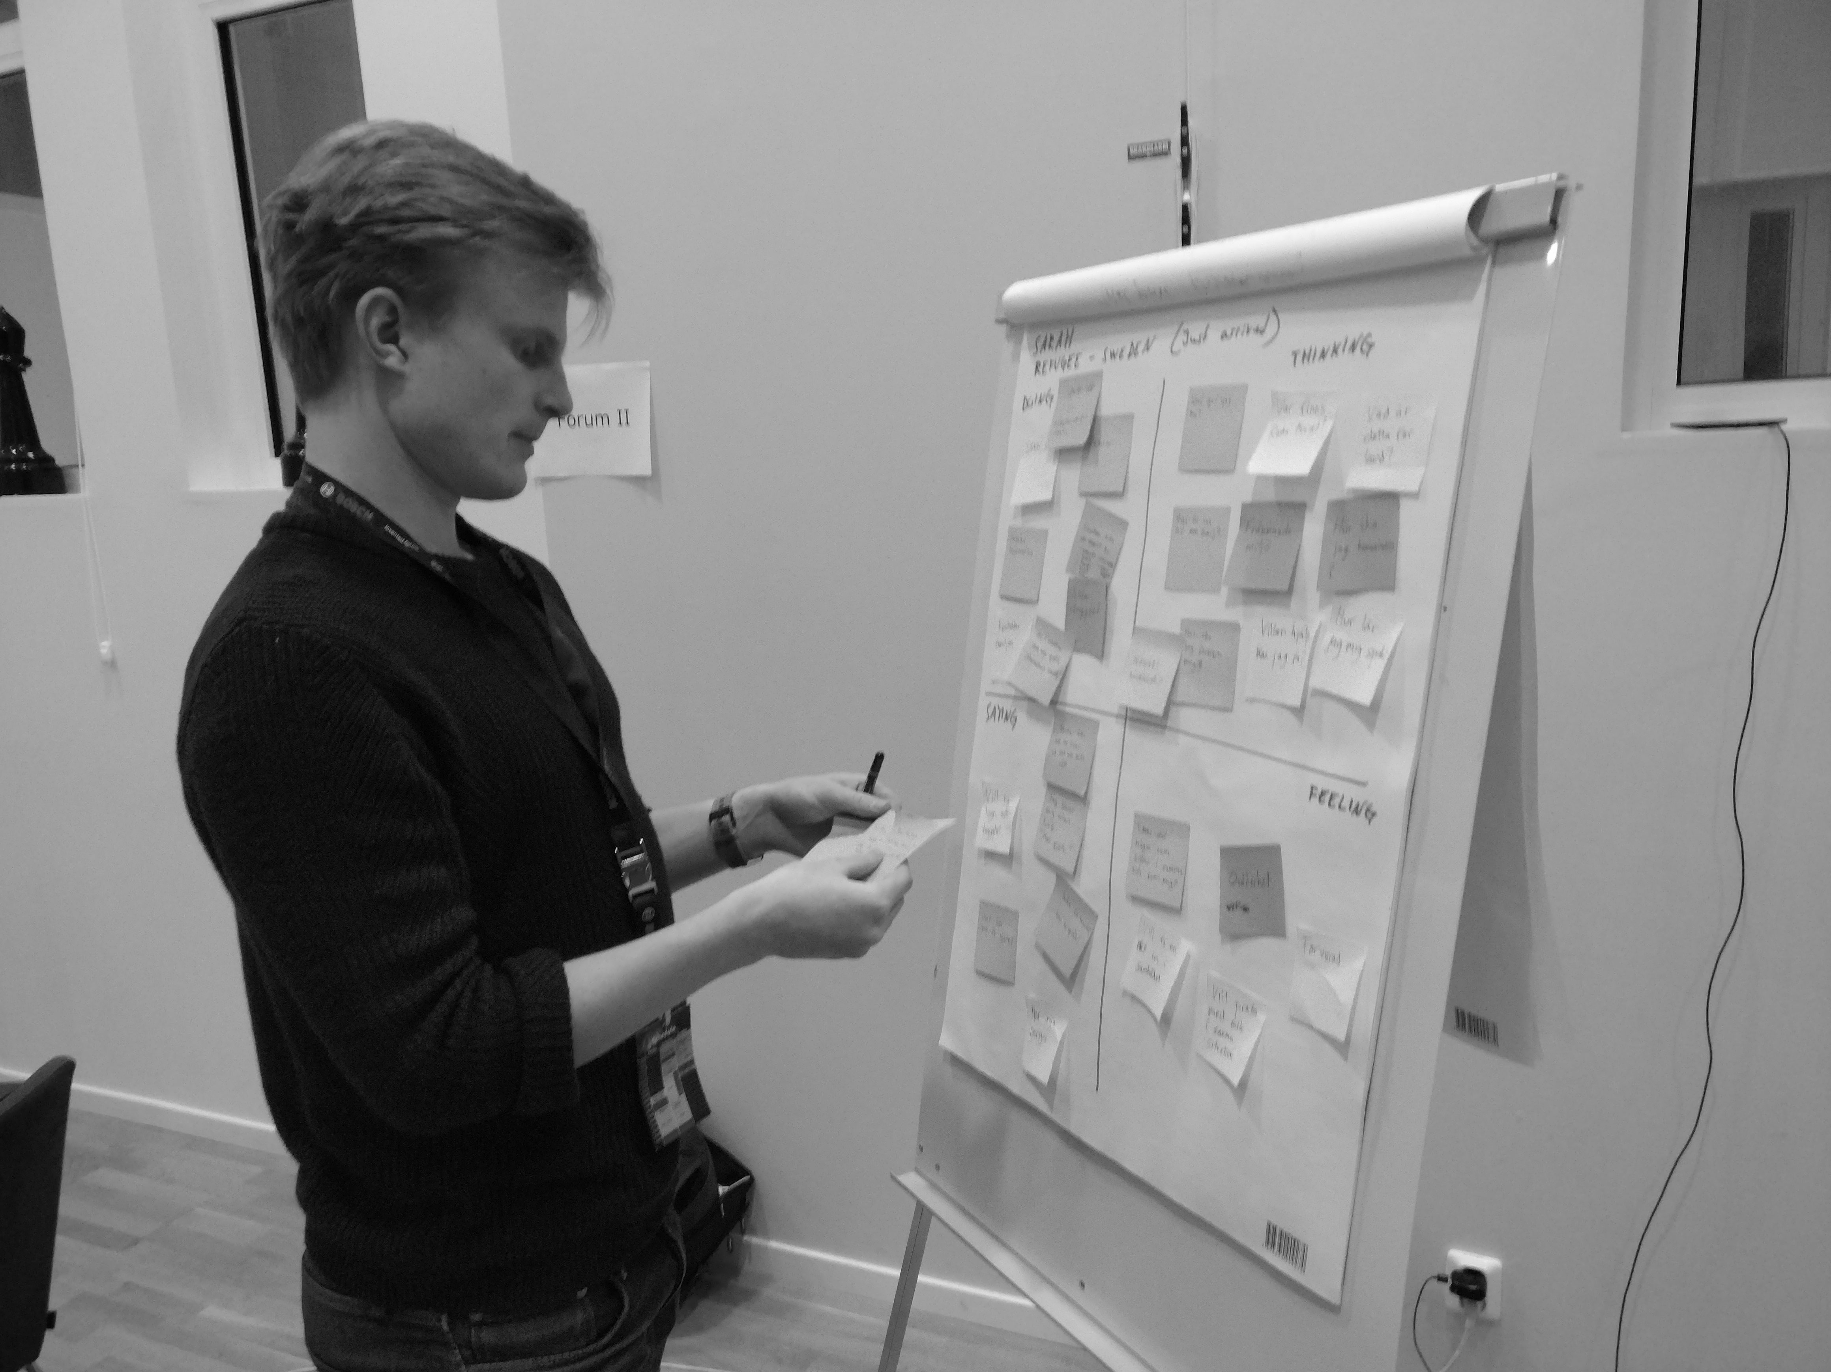

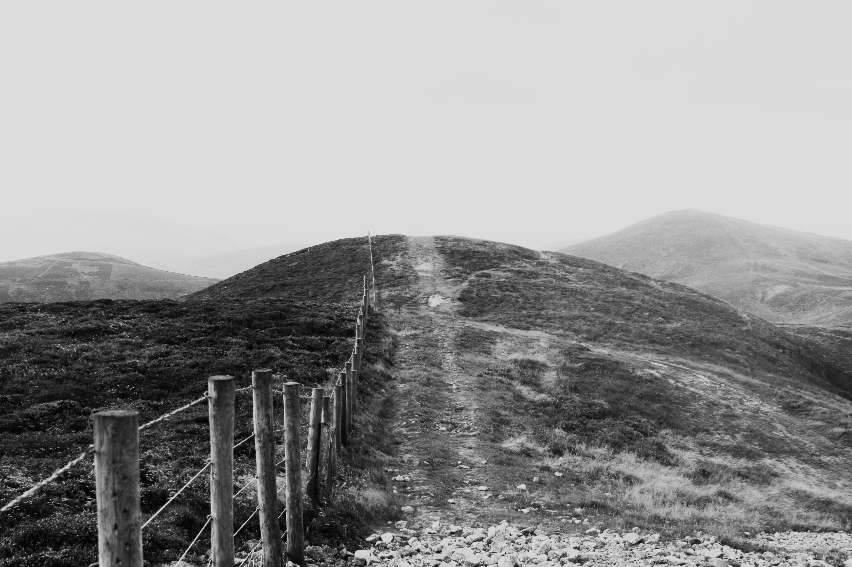
PROCESS
1. Personas
2. Problem Areas
3. Goals
Notes:
We spent hours planning and utilized Design Thinking to create personas that would represent people engaged with the Red Cross.
Out of all this, we identified two goals that would be highly beneficial for the Red Cross to reach:

Slide 3
GOALS
Volunteers should be encouraged to exchange knowledge with each other.
2. The Red Cross wants to improve their planning, with more feedback.
Notes:
Volunteers should be encouraged to exchange knowledge and info between each other.
And The Red Cross wants to improve their planning, by receiving more feedback.
We have of course created a prototype for this. Here it is:

Slide 4
Demo

Slide 5
Further Development

Slide 6

FURTHER DEVELOPMENTS - Communication
People connected if similar demand or interest -> Discussion
Events is created automatically. Machine learning. Develops as demand changes.
Event
Notes:
If people need similar help — will be connected in app — discuss & exchange experiences.
This applies to Volunteers as well - Thus helping in same location gets connected.
(could also be based same interest, event, experience.)
When demand — high in an area — specific thing —> events is created automatically.
No need for planning before help is sent.
Event develops as demand changes. (Data learning). - Up to date

Slide 7
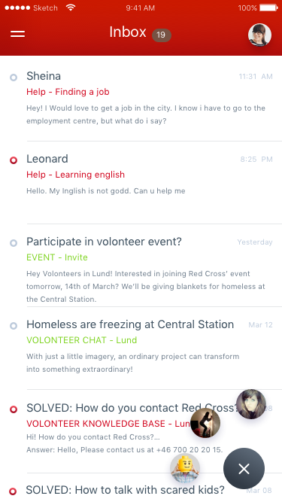
FURTHER DEVELOPMENTS - Communication
Discussion, other communication & information - in (filterable) Inbox
Notes:
And here’s the Mockups - how it would look - All the communication & information

Slide 8
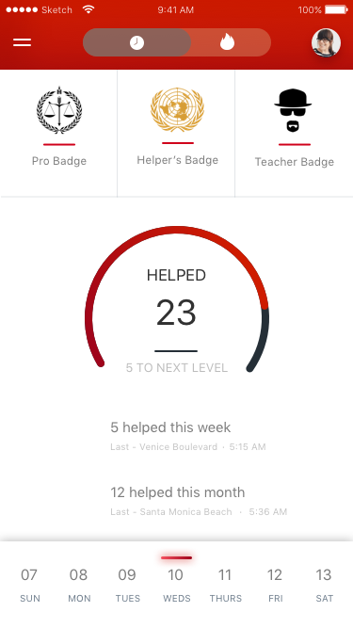

FURTHER DEVELOPMENTS - Value to users
- Also, Exclusive Real life achievements.
Feedback & Thanks
Feel Valuable.
Just By helping people.
Notes:
To provide value for user -

Slide 9
FURTHER DEVELOPMENTS - Admin & Organization
Organisational dashboard - Add, edit, view events. Analyze big data.
Send interactive forms to users and volunteers for more feedback.
<div>EDIT</div>
Notes:
Organisational dashboard view - admin events, add. Send interactive forms to users and volunteers for more feedback.
And analyse data.

Slide 10
Notes:
So, what have we created ?
1. a per2per platform where volunteers can instantly help people in need. And applied gamification for the volunteers.
- 2. Made it possible to take action based on the real time demand and deploy resources accordingly. Real time demand is the feedback!
- 3. A platform for volunteers and people in need to connect and exchange experiences.
We really hope this have created some value for the red cross. Thank you!

